Slide 1
UNIT-5
8051 -INTERFACING

Slide 2
8051-INTERFACING WITH LCD

Slide 3
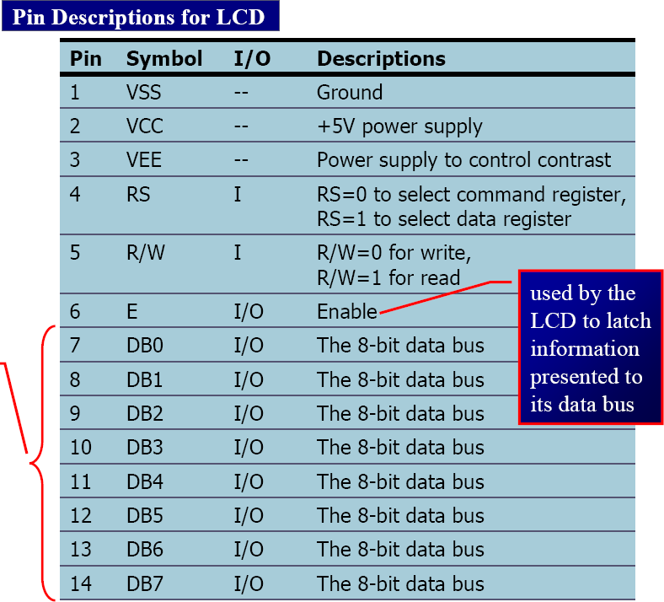

8051 Interfacing LCD (Liquid Crystal Display)
Prepared By: Ms. K. D. Patil
4

Slide 4
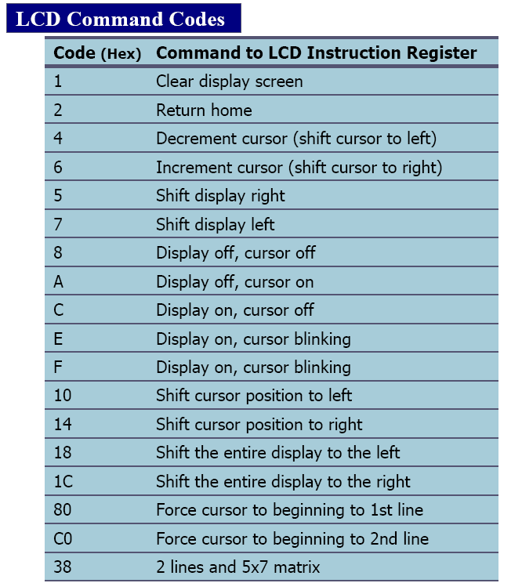
Prepared By: Ms. K. D. Patil
5

Slide 5


Pin Connection
Prepared By: Ms. K. D. Patil
6
P0
D0
+5V
VCC
LCD
VEE
10K POT
P7
D7
8051
VSS
RS R/W E
P3.2
P3.3

Slide 6
LCD Program
Prepared By: Ms. K. D. Patil
7
org 0000h
mov a,#38h
acall comm
acall delay
; INITIALIZE 2 line 5x7
;CALL COMMAND SUBROUTINE
;GIVE LCD SOME TIME
mov a,#0eh
acall comm
acall delay
;DISPLAY ON,CURSOR ON
;CALL COMMAND SUBROUTINE
mov a,#01h
acall comm
acall delay
;clear LCD
mov a,#06h
acall comm
acall delay
;shift cursor right
mov a,#80h
acall comm
acall delay
;FORCE CURSOR TO BEGINNING OF FIRST LINE

Slide 7
LCD Program
Prepared By: Ms. K. D. Patil
8
mov a,#„S'
acall data1 ;CALL DISPLAY ROUTINE
acall delay
mov a,#'R'
acall data1
acall delay
mov a,#„E'
acall data1
acall delay
mov a,#'S'
acall data1
acall delay

Slide 8
LCD Program
Prepared By: Ms. K. D. Patil
9
comm:
;SEND COMMAND TO LCD
;COPY REG A TO PORT0
;RS=0 FOR COMMAND
;R/W=0 FOR WRITE
;E=1
;E=0
•
•
•
•
•
mov p0,a clr p2.2 clr p2.1 setb p2.0 clr p2.0 ret
data1:
;WRITE DATA TO LCD
• | mov p0,a | ;COPY REG A TO PORT0
• | setb p2.2 | ;RS=1 FOR DATA
• | clr p2.1 | ;R/W=0 FOR WRITE
• | setb p2.0 | ;E=1
• | clr p2.0 | ;E=0
 | ret
delay: | mov r1,#255
here2: | mov r2,#255
here: | djnz r2,here
• | djnz r1,here2
Ret
end

Slide 9
8051-INTERFACING WITH LED

Slide 10
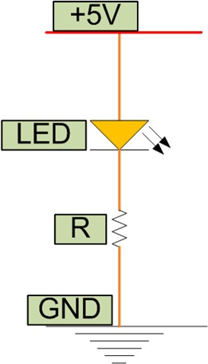
8051 Interfacing LED
Prepared By: Ms. K. D. Patil
10
LED (Light Emitting Diode) is a P N junction diode which emits light when activated.
It is activated when the PN junction sustains a forward voltage (forward bias), a current from P to N, called forward current.
When this current is applied, electrons recombine with electron holes within the device thereby releasing energy in form of light.
LED finds application in traffic signals,
lighting, camera flashes etc.
The way to distinguish between the positive and negative terminal is, the positive is longer than the negative in length.

Slide 11
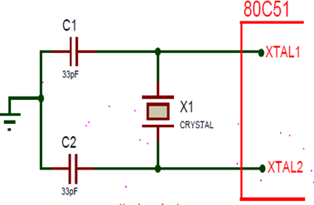
8051 Interfacing LED
Prepared By: Ms. K. D. Patil
11
While LEDs are interfaced with 8051, Quartz crystals or ceramic resonator that determines the operating frequency of 8051 microcontroller is needed.
The XTAL1 and XTAL2 can be configured in two ways;
  external clock drive configuration
  internal clock drive configuration.
Two capacitors C1 and C2 are connected to the quartz crystal. It can be a quartz crystal or ceramic resonator.
The crystal oscillator frequency is from 1.2MHz to 12MHz. The crystal oscillator is used to generate clock pulses that provide the means for timing calculation.
Crystal pins are connected to the ground through capacitors of 33pf.

Slide 12
8051 Interfacing LED
Prepared By: Ms. K. D. Patil
12
In the following Diagram, LEDs are connected to the port P0.
LEDs need approximately voltage drop of 1.7V and 10mA current to flow through them in order to glow at maximum intensity.

Slide 13
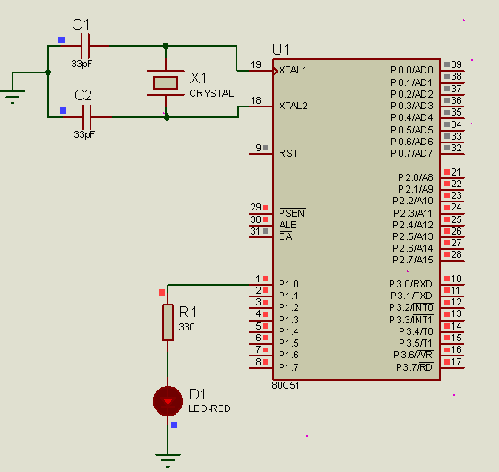
8051 Interfacing LED
Prepared By: Ms. K. D. Patil
13

Slide 14
8051-INTERFACING WITH 7 SEGMENT DISPLAY

Slide 15
8051 Interfacing 7 Segment Display
Prepared By: Ms. K. D. Patil
14
7 segment display is a 10 pin electronic component with eight led’s embedded inside it to displays number from 0 to 9 even we can display few characters like A, B, C, H, E, e, F, etc. .
It is available in two configurations:
  common cathode
  common anode
In Common Anode to light up any given segment the corresponding Cathode pin should be connected to ground or reference ,which completes the circuit and LED will be in forward bias.
In Common Cathode to corresponding LED Anode pin the circuit will be completed and the particular LED will be light up since it will be in forward bias.

Slide 16
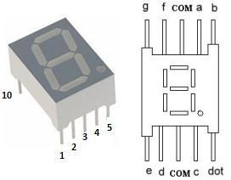
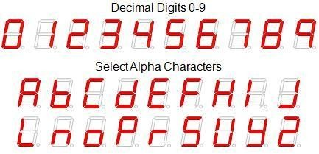
8051 Interfacing 7 Segment Display
Prepared By: Ms. K. D. Patil
15
A seven segment display consists
of seven LEDs arranged in the form of a “squarish eight”
slightly inclined to the right and a single LED as the dot character.
Different characters can be
displayed by selectively glowing
the required LED segments.

Slide 17
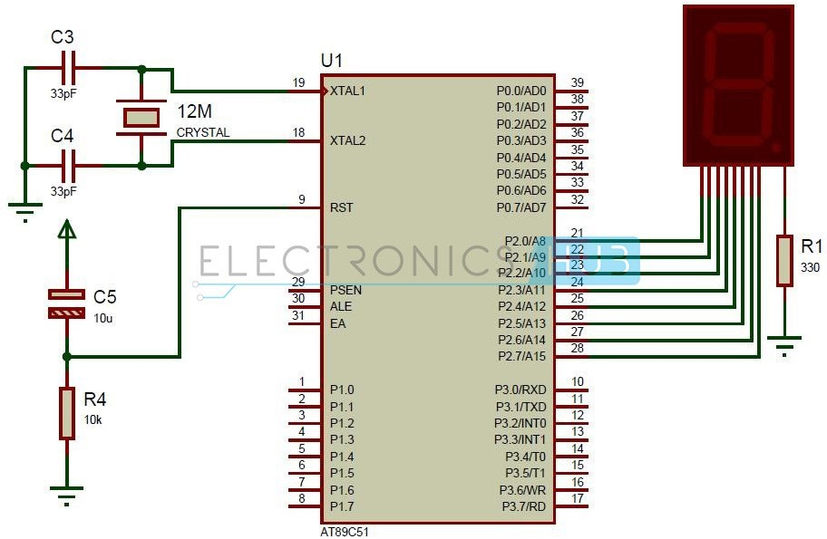
8051 Interfacing 7 Segment Display
Prepared By: Ms. K. D. Patil
16

Slide 18
8051 INTERFACING WITH ADC

Slide 19
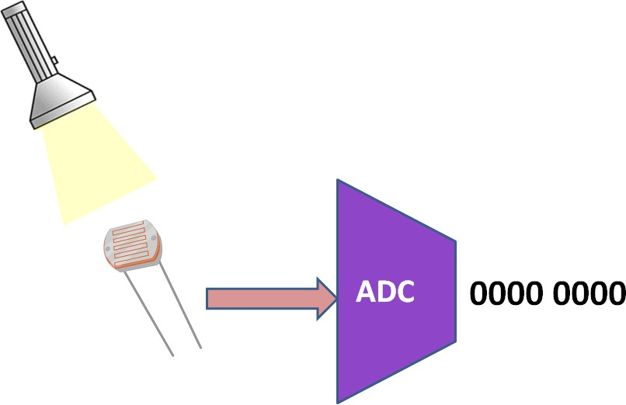
8051 Interfacing ADC
Prepared By: Ms. K. D. Patil
17
Digital computers use binary values but in physical world everything is Analog (continuous) eg. Temperature, Pressure
A physical quantity is converted into electrical (voltage, current) signals using a device called as Transducer (also referred as Sensors).
We need Analog-to-Digital converter (ADC) to translate Analog signals to Digital number so that Microcontroller can read and process them.
ADC0808 allows us to monitor upto 8 different analog input channels using single chip

Slide 20
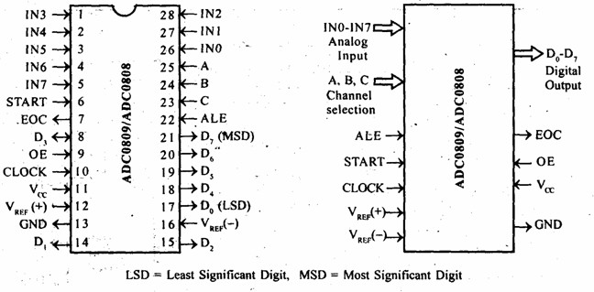
ADC0808
Prepared By: Ms. K. D. Patil
18

Slide 21
Address Lines (A,B,C)
Prepared By: Ms. K. D. Patil
19
Selected ADC channel | C | B | A
IN0 | 0 | 0 | 0
IN1 | 0 | 0 | 1
IN2 | 0 | 1 | 0
IN3 | 0 | 1 | 1
IN4 | 1 | 0 | 0
IN5 | 1 | 0 | 1
IN6 | 1 | 1 | 0
IN7 | 1 | 1 | 1
ADC0808 has 8-bit data output
8 analog input channels are multiplexed and selected using three address pins A, B & C.

Slide 22
Signals for A/D Conversion
Prepared By: Ms. K. D. Patil
20
Address Latch Enable (ALE): A LOW-TO-HIGH signal at this pin will latch the above-selected address and selected the respective channel for ADC conversion.
START Conversion (SC): The A/D converter‟s successive approximation register (SAR) is reset on the positive edge of the start conversion (SC) pulse. Thus we need to generate a LOW- HIGH pulse for starting the ADC conversion.
End of Conversion (EOC): Once the conversion is over, this pin is pulled HIGH by ADC0808. This pin needs to be monitored for the conversion to complete and then read the data.
Output Enable(OE): ADC0808 does the A/D conversion and holds the data in the internal registers. A HIGH signal on this pin will bring the data on the output lines.
D0-D7 are the digital Data output lines.

Slide 23
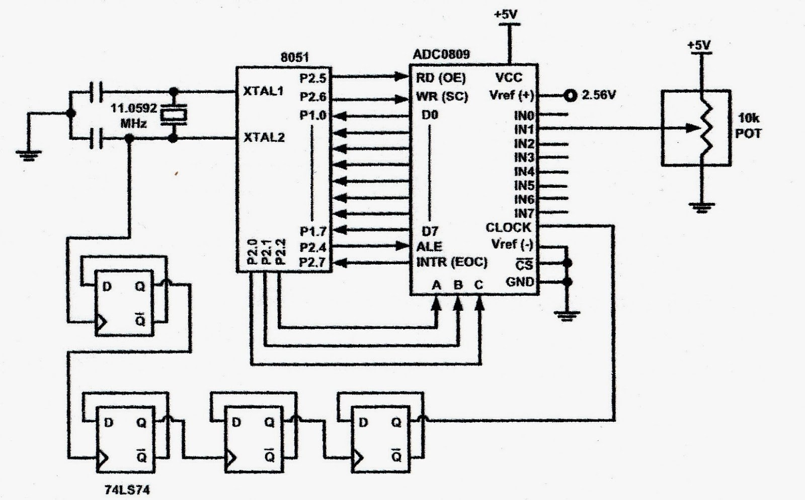
8051 Interfacing ADC
Prepared By: Ms. K. D. Patil
21

Slide 24
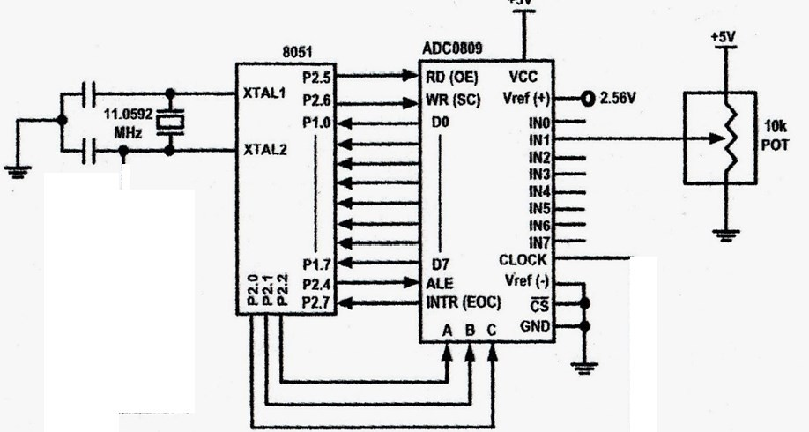
8051 Interfacing ADC
Prepared By: Ms. K. D. Patil
22

Slide 25
8051 Interfacing Temperature Sensor (LM34/LM35)
Prepared By: Ms. K. D. Patil
23
Temperature is converted to electrical signals using a transducer called as Thermistor.
Simple and widely used Temperature sensors include LM34 & LM35 from Semiconductor Corp
LM34 does not require external calibration since it is internally calibrated.
LM35 are precision integrated circuit temperature sensors whose output voltage is linearly proportional to Celsius temp. It does not require external calibration since it is internally calibrated. It outputs 10mV for each degree of centigrade temperature.

Slide 26
Signal Conditioning
Prepared By: Ms. K. D. Patil
24
Sensors produce the output in the form of voltage, current, charge, resistance & capacitance.
But, we need to convert these signals to voltage in order to send input to ADC.
This conversion is called as Signal conditioning.
Signal conditioning can be current to voltage conversion or signal amplification.
Analog World (temperature, pressure)
Transducer (Sensor)
Signal Conditioning
ADC
Microcontroller

Slide 27
Connecting LM35 to ADC
Prepared By: Ms. K. D. Patil
25
Since ADC has 8 bit resolution with a max of 256 steps and LM35 produces 10mV for every degree of temperature change, we can condition Vin of the ADC to produce a Vout of 2.56V for full scale output. So
Vref= 2.56
Temperature Vs Vout for ADC
Temp (C) | Vin (mV) | Vout (D7-D0)
0 | 0 | 0000 0000
1 | 10 | 0000 0001
2 | 20 | 0000 0010
3 | 30 | 0000 0011
10 | 100 | 0000 1010
30 | 300 | 0001 1110

Slide 28
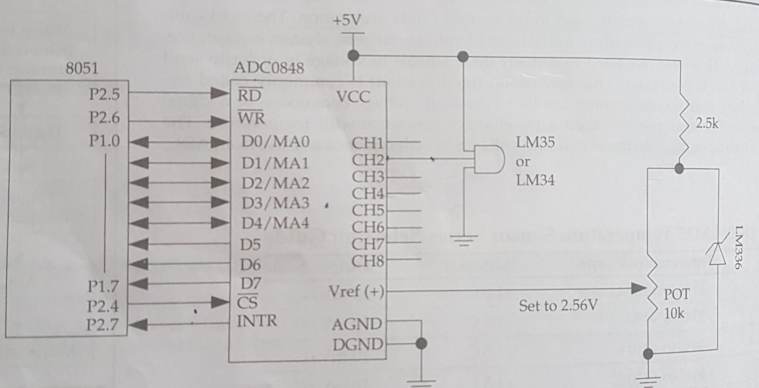
Prepared By: Ms. K. D. Patil
26
Interfacing Diagram

Slide 29
8051 INTERFACING WITH DAC

Slide 30
8051 Interfacing DAC
Prepared By: Ms. K. D. Patil
27
Microcontroller are used in wide variety of applications like for measuring and control of physical quantity like temperature, pressure, speed, distance, etc.
In these systems microcontroller generates output which is in digital form but the controlling system requires analog signal as they don't accept digital data thus making it necessary to use DAC which converts digital data into equivalent analog voltage
Digital to Analog Converter is a device used to convert digital
pulses to analog signals.
In the figure shown, we use 8-bit DAC 0808. This IC converts digital data into equivalent analog Current. Hence we require an I to V converter to convert this current into equivalent voltage.
DAC0808 provides 256 discrete voltage (or current) levels of output.

Slide 31
DAC0808
Prepared By: Ms. K. D. Patil
28
In the MC1408 (DAC0808), the digital inputs are converted to current (I_{out}), and by connecting a resistor to the I_{out} pin, we convert the result to voltage.
The total current provided by the I_{out} pin is a function of the binary numbers at the D0 – D7 inputs of the DAC0808 and the reference current (I_{re}f), and is as follows:
where D0 is the LSB, D7 is the MSB for the inputs, and I_{re}f is the input current that must be applied to pin 14. The I_{re}f current is generally set to 2.0 mA.

Slide 32
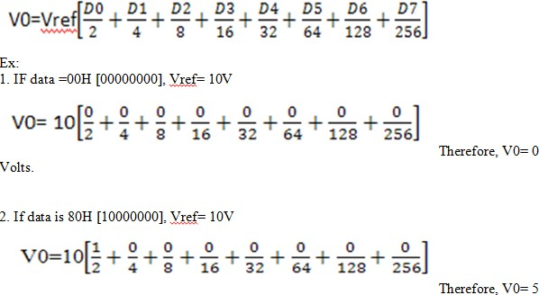
Prepared By: Ms. K. D. Patil
29

Slide 33
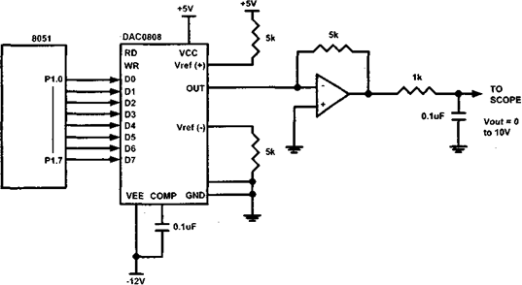
Interfacing Diagram
Prepared By: Ms. K. D. Patil
30

Slide 34
8051 INTERFACING WITH
STEPPER MOTOR

Slide 35
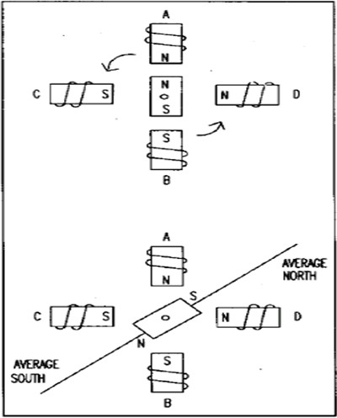
8051 Interfacing Stepper Motor
Prepared By: Ms. K. D. Patil
31
Stepper motor is a widely used device that translates electrical pulses into mechanical movement
Stepper motor is used in applications for position control such as
  disk drives
  dot matrix printer
  robotics etc.
Stepper motors commonly have a permanent magnet rotor (shaft) surrounded by a stator

Slide 36
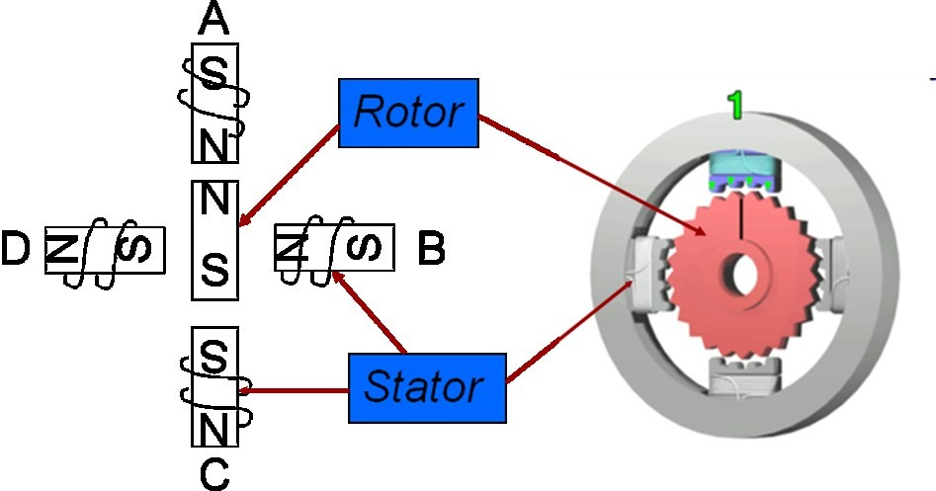
Prepared By: Ms. K. D. Patil
32
Commonly
used
stepper
motors have four stator
windings that are paired
with a center – tapped
common. Such motors are
called as four-phase or
unipolar stepper motor.
It has a permanent magnet
rotor (shaft) which is
surrounded by a stator.
A
practical PM stepper
motor will have 1.8 degrees
step angle and 50 tooth on its rotor.
There are 8 main poles on
the stator, each having 5 tooth in the pole face

Slide 37
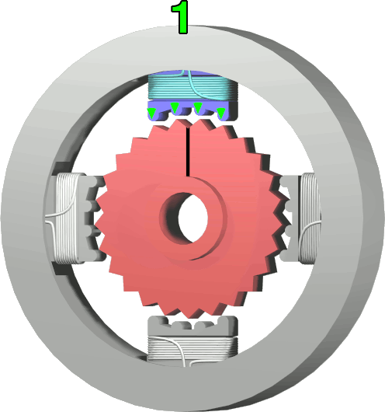
Prepared By: Ms. K. D. Patil
33

Slide 38
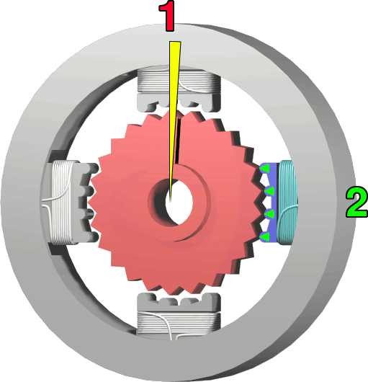
Prepared By: Ms. K. D. Patil
34

Slide 39
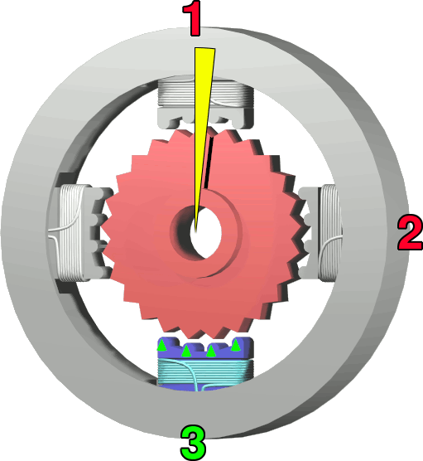
Prepared By: Ms. K. D. Patil
35

Slide 40
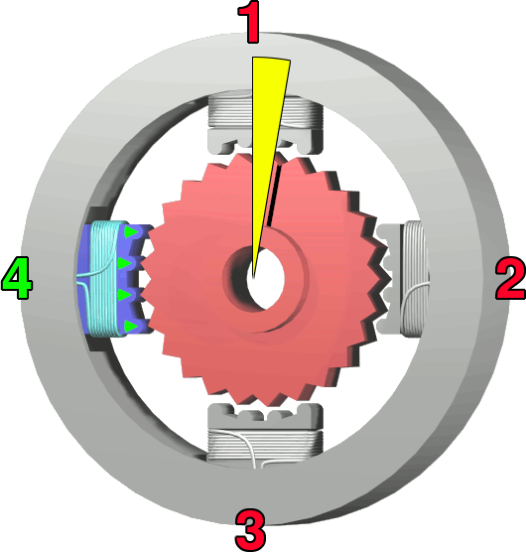
Prepared By: Ms. K. D. Patil
36

Slide 41
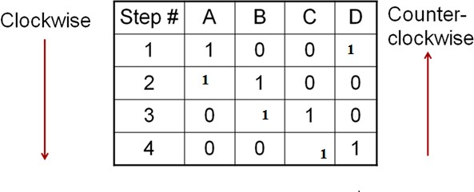
4 step Sequence
Prepared By: Ms. K. D. Patil
37
Step | Windi ng A | Windi ng B | Windi ng C | Windi ng D
1 | 1 | 0 | 0 | 1
2 | 1 | 1 | 0 | 0
3 | 0 | 1 | 1 | 0
4 | 0 | 0 | 1 | 1

Slide 42
Step Angle
Prepared By: Ms. K. D. Patil
38
Step angle is defined as the minimum degree of rotation associated with a single step.
Total number of steps needed to rotate 360 degrees is
Steps per Revolution.
No of steps per revolution = 360° / step angle
Steps per second = (rpm x steps per revolution) / 60
Example: step angle = 2°
No of steps per revolution = 180

Slide 43
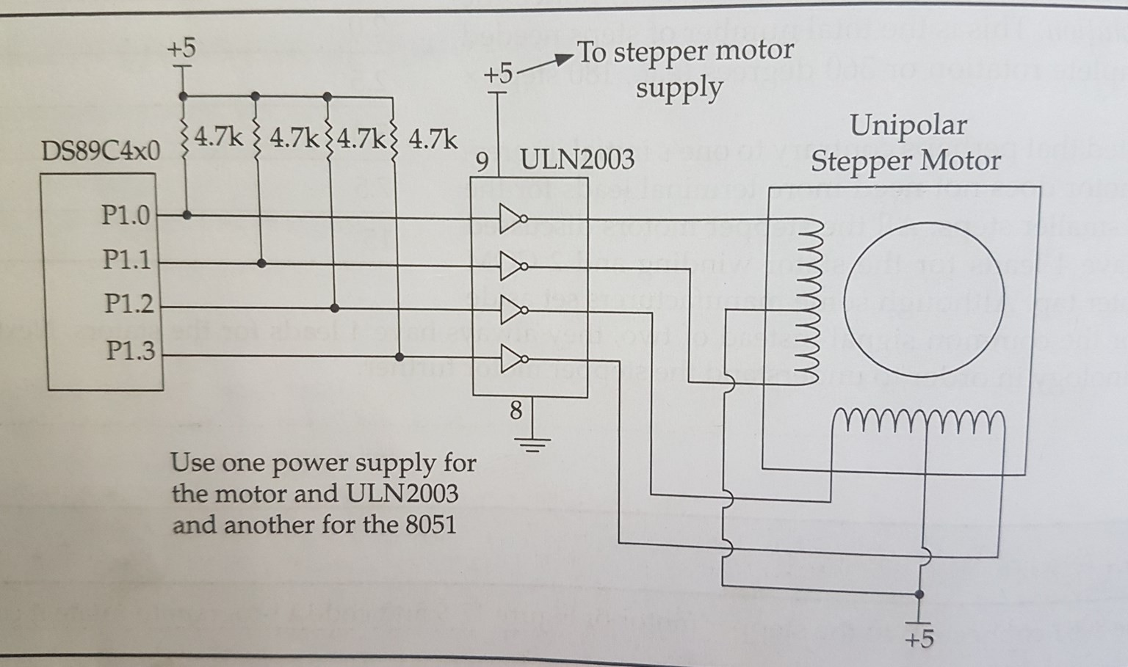
Interfacing Diagram
Prepared By: Ms. K. D. Patil
39

Slide 44
8051 INTERFACING WITH KEYBOARD

Slide 45
8051 Interfacing Keyboard
Prepared By: Ms. K. D. Patil
40
Keyboards are organized in a matrix of rows and columns.
The CPU processes both rows and columns through ports
So, with two 8-bit ports, an 8X8 matrix of keys can be connected to the controller.
When a key is pressed, a row and a column make a contact. Otherwise there is no connection
In microcontroller, programs stored in EPROM scan the keys continuously.
In the following figure, 4 X 4 matrix connected to two ports. rows are connected to output ports and columns are connected to an input port.

Slide 46
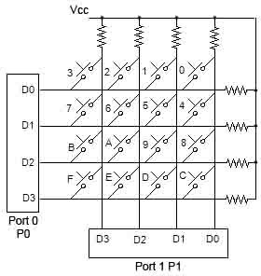
Matrix Keyboard connection to Ports
Prepared By: Ms. K. D. Patil
41

Slide 47
Scanning & Identifying Key
Prepared By: Ms. K. D. Patil
42
It is a function of microcontroller to scan the keyboard continuously to detect and identify key pressed
To detect Pressed key microcontroller grounds all rows by providing 0 to output latch, then it reads the columns
  If the data read from columns is D3-D0 = 1111 , no key is pressed and the process continues till key press is detected.
  If one of the column bits has a zero, means key press has
occurred.
    If D3-D0 = 1101 this means that key in the column D1 has been pressed.
    After detecting a key press, microcontroller will go through the process
of identifying key.

Slide 48
Scanning & Identifying Key
Prepared By: Ms. K. D. Patil
43
Starting with the top Row, the microcontroller grounds it by providing a low to Row D0 only
  If reads a column if data read is all 1s, no key in that row is
activated and the process is moved to the next row.
It grounds the next row, reads the columns, and checks for any zero
  This process continues until row is identified
After identification of the Row in which Key has been pressed, find out column the key press belongs to

Slide 49
THANK YOU

